Slide 1
第9课 在LabVIEW中访问文件
解释文件I/O的基本概念，并根据情况选择恰当的文件I/O。
在LabVIEW中访问文件
高层和底层文件I/O函数
比较文件格式

Slide 2
A. 在LabVIEW中访问文件
认识在LabVIEW应用程序中写入和读取文件的步骤。

Slide 3
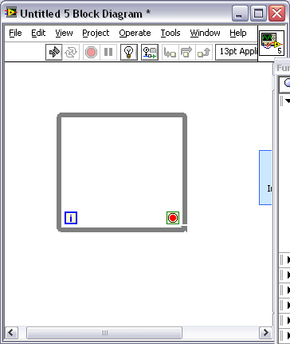
A. 在LabVIEW中访问文件
常规文件I/O操作步骤
打开/ 创建/ 替换文件
读取
和/或 写入文件
关闭
文件
检查
错误
Notes:
File I/O operations pass data to and from files. Use the File I/O VIs and functions to handle all aspects of file I/O.
A typical file operation involves the following process: Open/Initialize/Create -> Read/Write -> Close the reference -> Check for errors

Slide 4
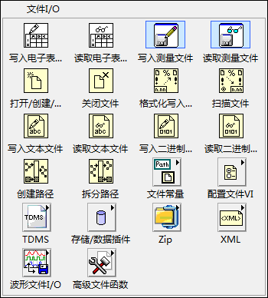
A. 在LabVIEW中访问文件
文件操作函数的文件I/O选板

Slide 5
B. 高层和底层文件I/O函数
认识高层和底层文件I/O函数的使用场景。

Slide 6
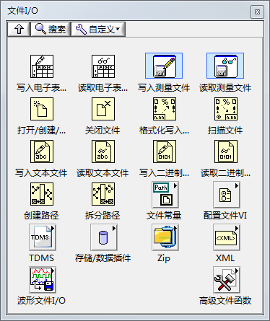
B. 高层和底层文件I/O函数
高层文件I/O
打开/ 创建/ 替换文件
读取
和/或 写入文件
关闭
文件
检查
错误
Notes:
High-level File I/O functions:
Perform all three steps (open, read/write, close) for common file I/O operations.
Might not be as efficient as the functions configured or designed for individual operations.
Write to Spreadsheet File
Converts an array of double-precision numbers to a text string and writes the string to an ASCII file.
Read From Spreadsheet File
Reads a specified number of lines or rows from a numeric text file and outputs a 2D array of double-precision numbers.
Write To/Read From Measurement File
Express VIs that write data to or read data from an LVM or TDMS file format.

Slide 7
练习9-1
了解高层文件I/O
观察一个高层文件I/O VI如何将数据写入电子表格文件。

Slide 8
练习9-1
了解高层文件I/O
如何在记录文件里添加更多列？

Slide 9
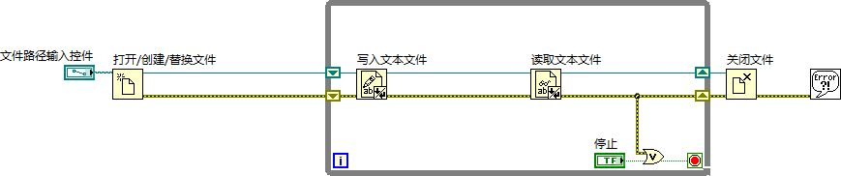
B. 高层和底层文件I/O函数
底层文件I/O
打开/ 创建/ 替换文件
读取
和/或 写入文件
关闭
文件
检查
错误
Notes:
A refnum is a temporary pointer to the resource

Slide 10
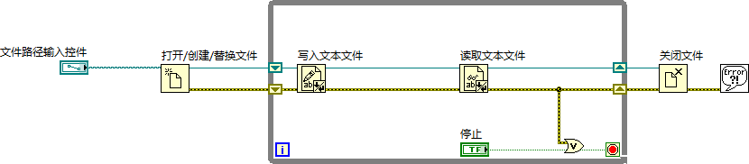
B. 高层和底层文件I/O函数
文件引用句柄
指定唯一的文件I/O会话。
引用句柄

Slide 11
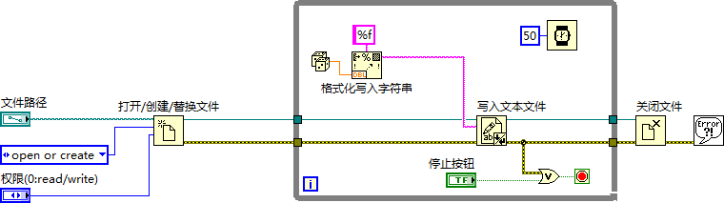
B. 高层和底层文件I/O函数
流盘
Notes:
Explain the concept of disk streaming here. Emphasize opening and closing the file outside of the loop.
Low-level File I/O functions:
Provide individual functions for each step.
Are efficient for writing to a file in a loop.

Slide 12
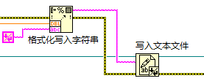
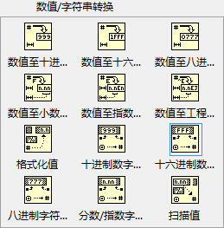
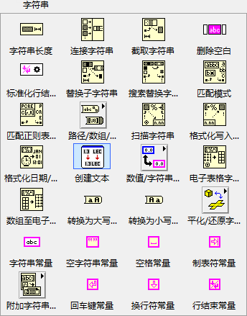

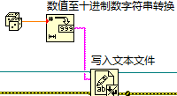
B. 高层和底层文件I/O函数
字符串函数
将数据转换为文本
Notes:
To write data to a text file, you must convert your data to a string. To write data to a spreadsheet file, you must format the string as a spreadsheet string, which is a string that includes delimiters, such as tabs.
Converting numeric and Boolean data types to strings and string operations basics

Slide 13
练习9-2
温度监视器VI－记录数据
修改VI，创建使用流盘的ASCII文件。

Slide 14
练习9-2
温度监视器VI－记录数据
如在While循环内使用了“打开/创建/替换文件”和“关闭文件”函数，会发生什么情况？

Slide 15
C. 比较文件格式
认识将数据记录至磁盘的几种方式。

Slide 16
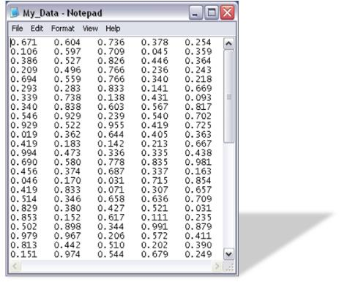
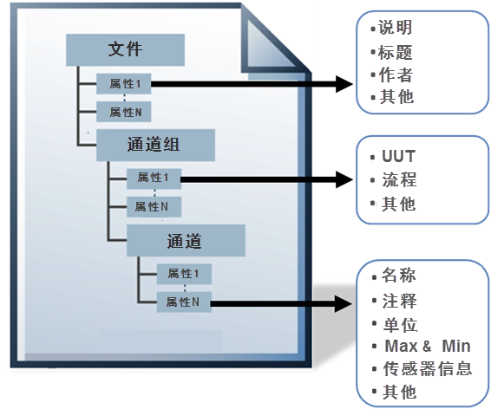
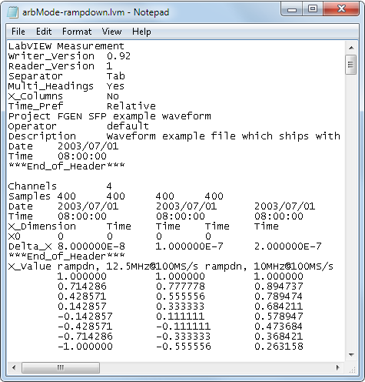
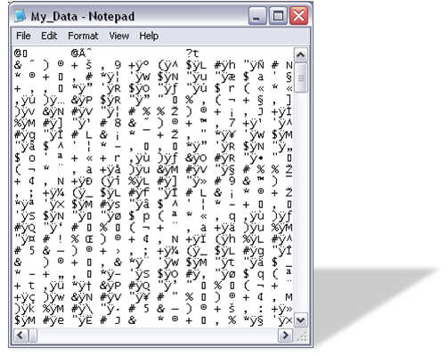
C. 比较文件格式
常见记录文件的格式
TDMS
ASCII/ LVM
二进制
Notes:
LabVIEW can use or create the following file formats:
Binary—Efficient, compact, and allows random access reading but not a human-readable file. Commonly used for high-speed and multi-channel DAQ.
ASCII—Human-readable text file where data is represented as strings. Commonly used for low-speed DAQ.
LVM—Format built on ASCII, the LabVIEW measurement data file (.lvm) is a tab-delimited text file you can open with a spreadsheet application or a text-editing application.
TDMS—An NI-specific binary file format that contains data and stores properties about the data.
ASCII files are also called text files.
Students will learn more about TDMS files in LabVIEW Core 2.

Slide 17

C. 比较文件格式
比较文件格式
 | ASCII | 二进制 | TDMS | LVM
易交换
占磁盘空间小
随机读/写访问
固有属性
高速流处理
Notes:
In this course, you learn about creating text (ASCII) files.
Use ASCII files in the following situations:
You want to access the file from another application.
Disk space and file I/O speed are not crucial.
You do not need to perform random access reads or writes.
Numeric precision is not important.

Slide 18

活动9-1
课程回顾
参考学员指南回答本课所学内容的相关问题，并分组进行讨论。

Slide 19
课程回顾
打开文件后，下列哪个输出为“打开/创建/替换文件”函数的返回值？
文件路径
文件名
引用句柄输出
任务输出
Notes:
Answer is c.

Slide 20
课程回顾
打开文件后，下列哪个输出为“打开/创建/替换文件”函数的返回值？
文件路径
文件名
引用句柄输出
任务输出
Notes:
Answer is c.

Slide 21
课程回顾
下列哪种文件格式最适用于需要高速流盘的应用程序？
ASCII
二进制
TDMS
LVM
Notes:
Answer is c.

Slide 22
课程回顾
下列哪种文件格式最适用于需要高速流盘的应用程序？
ASCII
二进制
TDMS
LVM
Notes:
Answer is c.

